Slide 1

Employee Data Analysis Using Excel
STUDENT NAME: KAVIYHA SHREE.D
REGISTER NO: 312209765
DEPARTMENT: B.COM(COMPUTER APPLICATION)
COLLEGE: ANNA ADARSH COLLEGE FOR WOMEN

Slide 2

PROJECT TITLE
Employee Performance Analysis Using Excel

Slide 3


AGENDA
1.ProbLEM STATEMENT
2.PROJECT OVERVIEW
3.End users
4.Our solution and proposition
5.Dataset description
6.Modelling approach
7.Results and discussion
8.conclusion

Slide 4


PROBLEM STATEMENT
Analysing employee performance to track their working skills and to motivate the low level employees by various tasks.
The HR department is struggling to effectively analyse and track employee performance data ,leading to:
-Inefficient use of resources.
-Poor decision making.
-Identify trends and patterns
To track the performance and give rewards to improve the current performance.

Slide 5

PROJECT OVERVIEW
In this project we know about the employees how they perform by various graph and pivot table
Collect and improve employee performance data into excel.
Implement filters and pivot tables to enable dynamic data.
Employee performance analysis is important to identify the performance level towards the project and improve their level by assigning new tasks to emerge themselves.

Slide 6

Who are the end users
HR Professionals
Managers and Supervisors.
Business Analysts.
Team Leads.
Employees Themselves.

Slide 7

OUR SOLUTION AND ITS VALUE PROPOSITION
OUR SOLUTION
Filtering – Remove missing
Charts – Visualization reports
Pivot table – Summary
Conditional formatting – Identify missing
Formula – Performance level
ITS VALUE PROPOSITION
Improve Data
Driven Decision Making
Better Talent Identification
Enhanced Performance Management

Slide 8

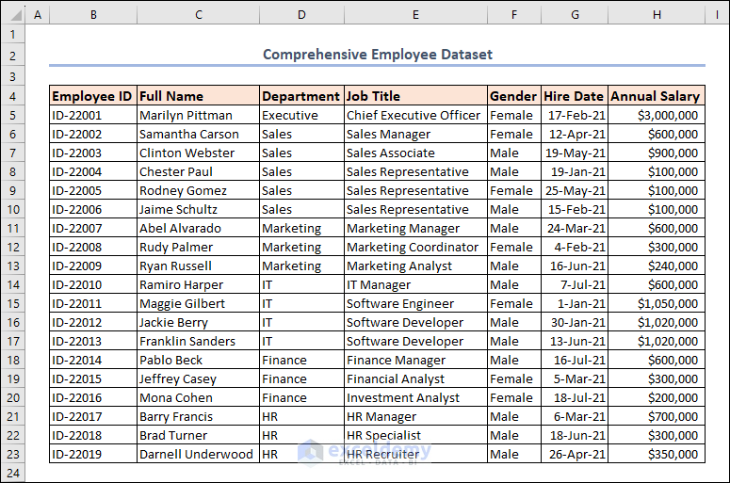
Dataset description
Employee ID
Full Name
Department
Designation
Hire Data
Annual Salary

Slide 9


MODELLING
DATA COLLECTION
The employee performance analysis table are taken from the website called Kaggle.
From the data we had some missing figures to identify the missing terms we use conditional techniques to identify the missing terms like exit data etc.
Then we use filtering and sorting to fill the missing figures.
Department-wise salary distribution.
Hire data distribution(to identify hiring trends)
Identification of top earners
FEATURE COLLECTION
Pivot table.
Charts.
Conditional formatting.

Slide 10

RESULTS

Slide 11

conclusion
From the above analysis the low level ,medium level to be improved by assigning various tasks and training in their field.
The current high and very high level employees are improve their intensity by rewards and appreciations towards their growth to increase their participation and to give more potential towards their project.

